Slide 1
The National Rural Employment Guarantee Act (NREGA) ANALYSIS
Deborah mark itonyo

Slide 2
Table of content
Introduction
Problem statement
Data cleaning
Visualizations
Trends
Conclusion
Recommendation

Slide 3
Introduction
The Mahatma Gandhi National Rural Employment Guarantee Act (NREGA), enacted in 2005, is an Indian labour law and social security measure aimed at enhancing the livelihood security of people in rural areas. The key features of NREGA include:
Right to Work: It guarantees 100 days of wage employment per financial year to rural households whose adult members volunteer to do unskilled manual work.
Employment Generation: The scheme aims to provide employment opportunities, reduce rural-urban migration, and enhance economic security for rural households.
Decentralized Implementation: NREGA is implemented through decentralized planning, involving local government bodies (Gram Panchayats) in the planning and execution of works.
Focus on Sustainable Development: The scheme prioritizes projects related to water conservation, drought-proofing, land development, and infrastructure improvement to promote sustainable rural development.
Social Inclusion: Special provisions are made to ensure the inclusion of marginalized communities, including Scheduled Castes (SC), Scheduled Tribes (ST), and women, in employment opportunities.
Transparency and Accountability: The act mandates the maintenance of proper records, public disclosure of information, and social audits to ensure transparency and accountability in its implementation.
NREGA is considered one of the largest and most ambitious social security and public works programs in the world, aimed at improving rural infrastructure and reducing poverty and inequality in India.

Slide 4
Problem statement
NREGA is a vital initiative to alleviate rural unemployment and poverty. This project seeks to address
several key questions and challenges associated with NREGA:
How effective is NREGA in providing employment opportunities to rural households?
Are there regional disparities in the implementation and outcomes of the scheme?
What is the utilization of the allocated budget, and how does it correlate with
employment generation?
4. What are the key factors contributing to the completion of NREGA works, and are there
any roadblocks to its success?
5. Can data-driven insights guide policymakers and administrators in optimizing the
scheme's impact?

Slide 5
Data cleaning
I corrected the data type for the different columns in the dataset.
I converted the columns in lakhs to full values by multiplying by 100,000
I reduced the decimal places to two decimal places so the data would be more readable.

Slide 6
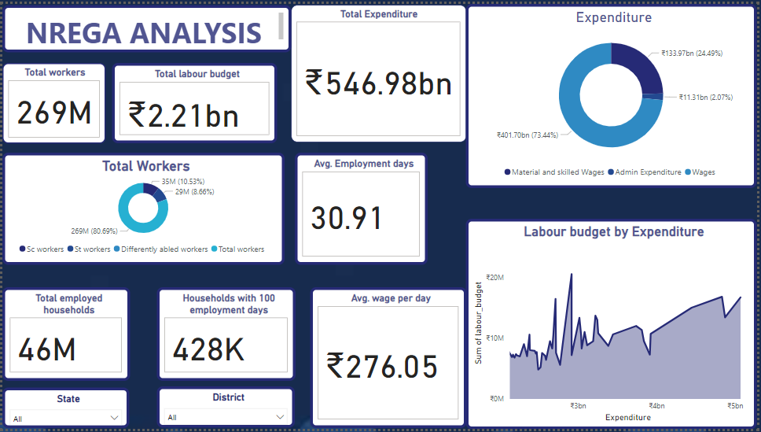
visualizations

Slide 7
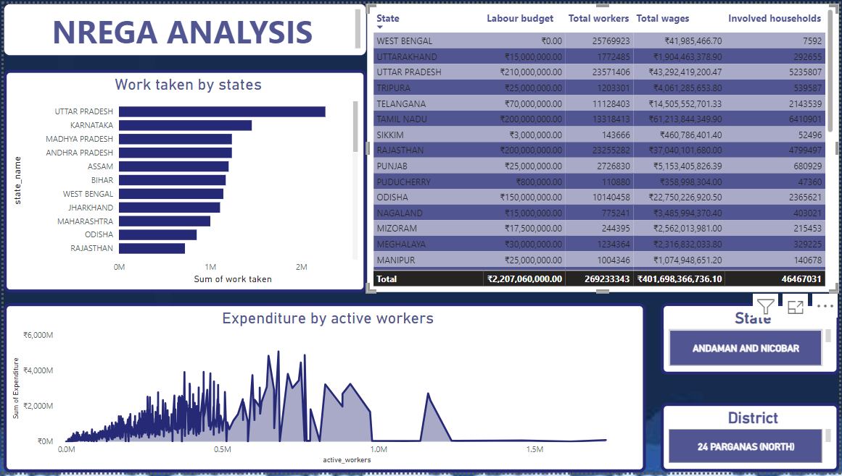
visualizations

Slide 8
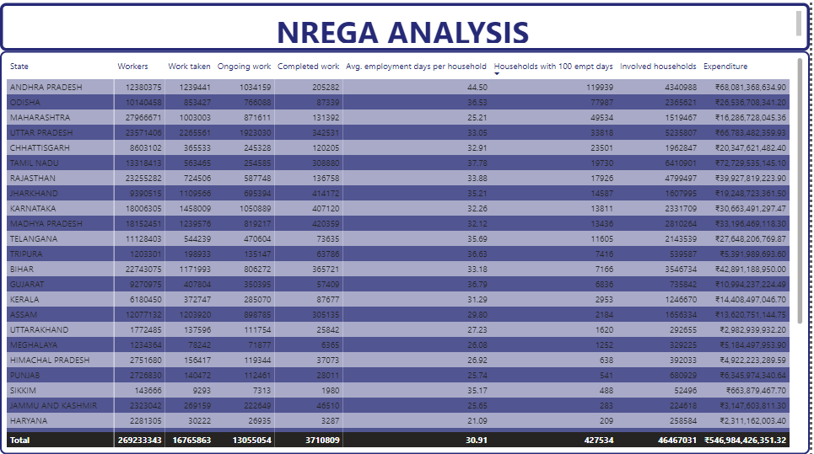
visualizations

Slide 9
trends
The average employment days is far behind what is excpected in a year, this gives only an average of 30.91 days out of a projected 100 days. It can be seen that the project is not effectively providing employment to rural households. Out of 46 million households participating in this program, only 428,000 households got 100 days of employment. This is 0.93%. So less than 1 percent truly get the benefit of this program.
It can be seen that different states has different outcomes concerning the implementation of this program. However, it can be seen that no state had up to 45 days of employment in a year.
The expense on wages far supersedes the labour budget. The wages make up 73.44% of the total expenditure and areas with more expenditure had more workers.
This insight shows that states with higher expenditure had more employment days and more completed work but some regional disparities also had a part to play in this

Slide 10
recommendations
Address Regional Disparities: Allocate higher budgets to areas with low worker participation and job availability to ensure a more equitable distribution of benefits.
Increase Employment Days: Aim to provide at least 60 days of employment per household on average.
Revise the Budget: Increase the labour budget to accommodate the higher actual expenditure on wages..
Issue More Job Cards: Ensure the number of job cards matches the number of workers to expand employment opportunities.
Promote Inclusivity: Increase the employment of SC, ST, and differently-abled workers to ensure social inclusion.
Data Enhancement: Collect and analyse more comprehensive data to gain deeper insights into the program's performance and areas for improvement.

Slide 11
conclusion
NREGA program falls short in providing adequate employment to rural households, with an average of only 30.91 days of employment per year against the projected 100 days. Only 0.93% of households received the full 100 days of work. Significant regional disparities exist, with no state averaging even 45 days of employment annually.
The wage expenditure, making up 73.44% of total costs, exceeds the allocated labour budget, indicating a need for budget revisions. States with higher expenditure show better outcomes, suggesting the importance of adequate funding.

